Slide 1
Introduction to Artificial Neural Networks
Dr. Sifat Momen

Slide 2
Goal: Build an Intelligent System
We need an architecture to be inspired by.
What is an intelligent system?
What should an intelligent system be able to do?
What could be a good example architecture of an intelligent system?

Slide 3
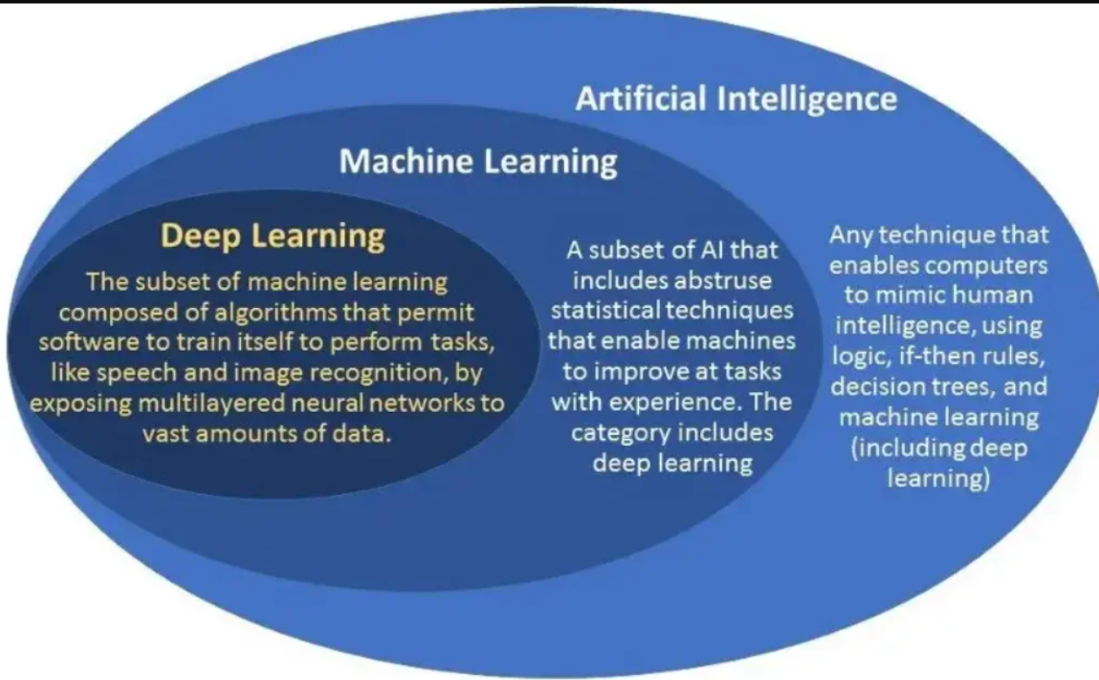
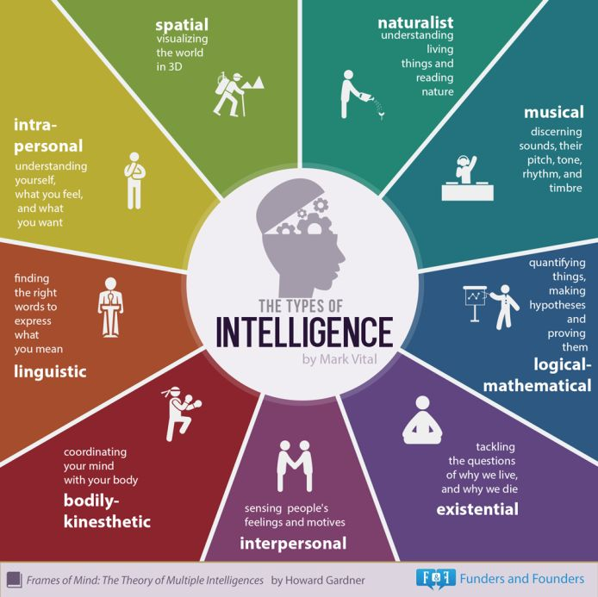
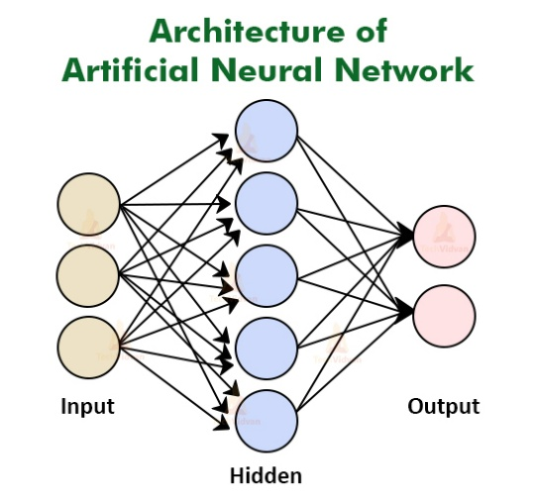
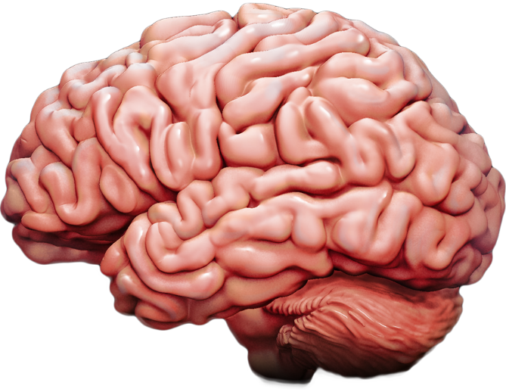
Goal: Build an Intelligent System
Human beings are
Versatile
Can do variety of tasks
Able to learn new concepts
Can solve complex tasks

Slide 4
Artificial Neural Network (ANN)
ANNs are at the very core of deep learning.
ANNs are versatile, powerful and scalable, making them ideal to large and highly complex ML tasks.

Slide 5
A brief history of Neural Networks (NNs)
(1943) Warren McCulloch & Walter Pitts introduced the idea of ANN in which they presented a computational model of how biological neurons can be used to perform computations using propositional logic
(1960s) It was clear that the promises would go unfulfilled and the funding flew elsewhere.
(1980s) New architectures were invented and better training techniques were developed, sparking a revival of interests in connectionism (study of NNs)
(1990s) The progress was slow, and other powerful ML techniques (such as SVMs) were developed. Again the study of NNs was put on hold.
(Now) There is another wave of interests in ANNs.
https://link.springer.com/article/10.1007/BF02478259

Slide 6
What makes it different this time?
Huge quantity of data is now available that can train sophisticated models that can outperform other ML techniques on very large and complex problems.
High computing power now makes it possible to train large neural networks in a reasonable amount of time.
We now have more improved training algorithms.
More funding has started pouring in to this area due to the rapid progress. More products based on ANNs make headline news, which pulls more and more attention and funding towards them.

Slide 7
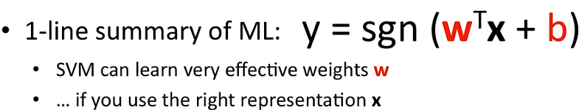
Features in Machine Learning

Slide 8
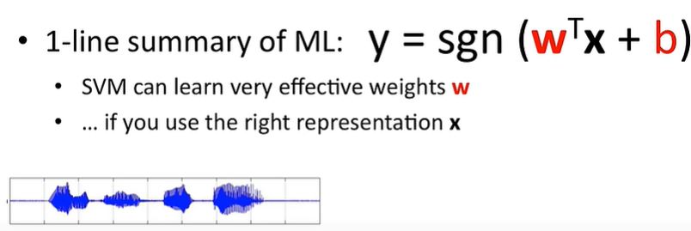
Features in Machine Learning

Slide 9
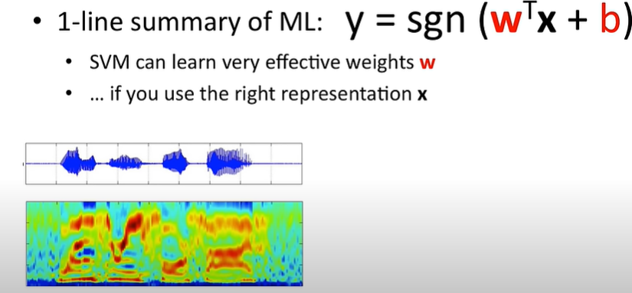
Features in Machine Learning

Slide 10
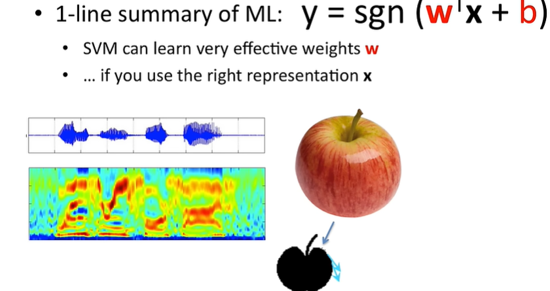
Features in Machine Learning

Slide 11
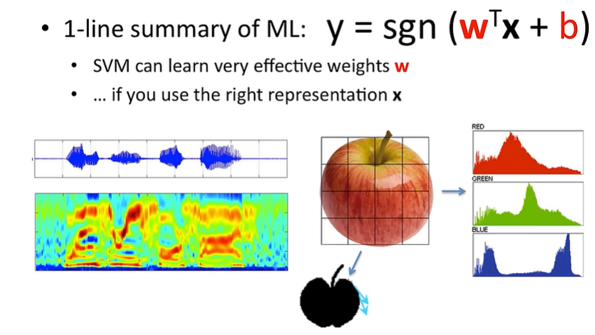
Features in Machine Learning

Slide 12
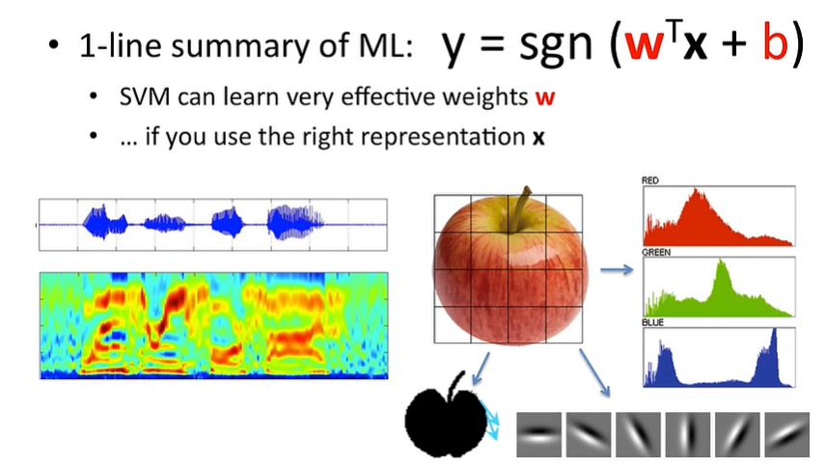
Features in Machine Learning

Slide 13
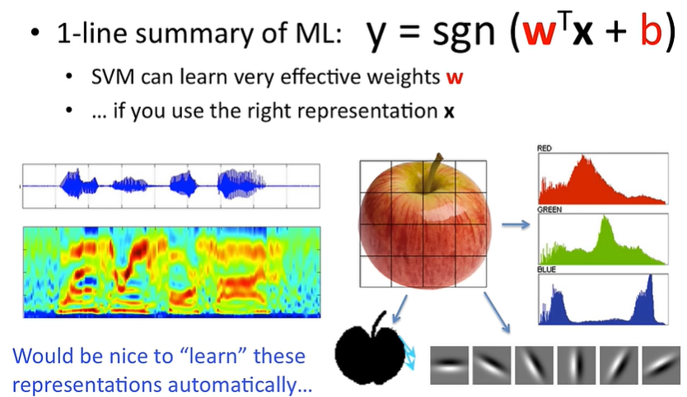
Features in Machine Learning

Slide 14
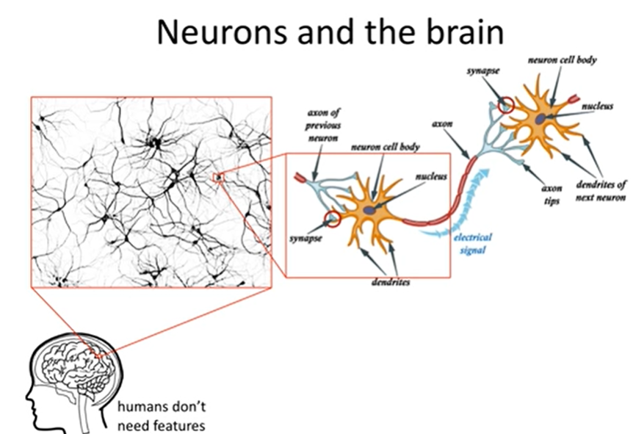

Slide 15
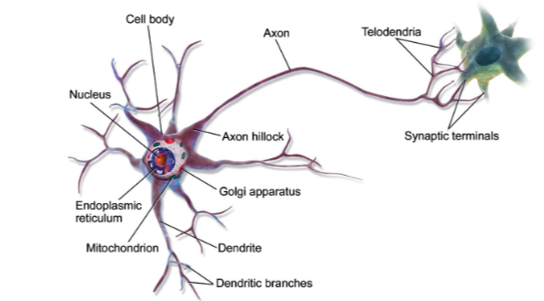
Biological Neurons
Biological Neuron: Unusually looking cell mostly found in animal brains.
It is composed of a cell body, containing the nucleus and most of the cell’s complex components, many branching extensions called dendrites, one very long extension called the axon.
Near its extremity, axon splits off into many branches called telondria, and at the tip of these branches are minisule structures called synaptic terminals (synapses), which are connected to the dendrites of other neurons.
Biological neurons produce short electrical impulses called action potentials (AP), which travel along the axons and make synapses release chemicals called neurotransmitters.

Slide 16
Biological Neurons
Individual biological neurons behave in a rather simple way, they are organized in a vast network of billions, with each neuron connected to thousands of other neurons.
Complex systems: https://netlogoweb.org/

Slide 17
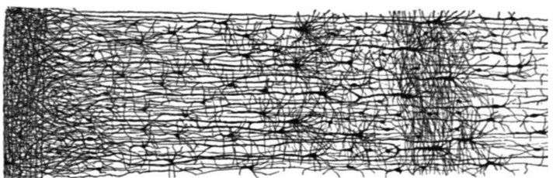
Biological Neurons
Neurons are often organized in consecutive layers, especially in the cerebral cortex.

Slide 18
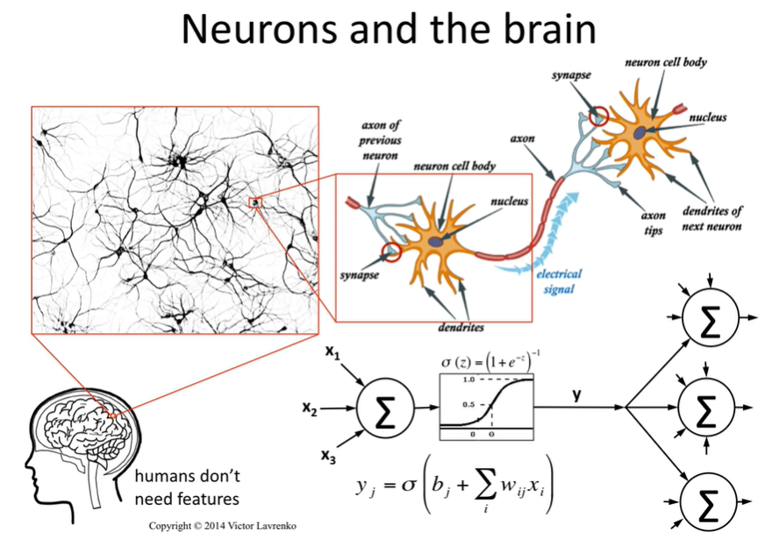

Slide 19
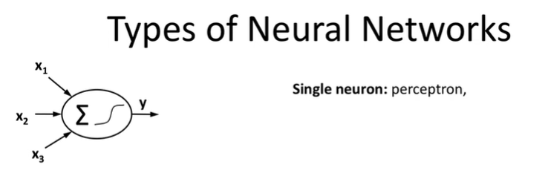

Slide 20
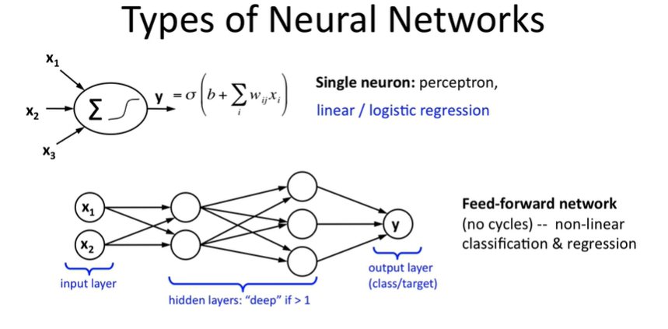

Slide 21
